Slide 1
TRT PoC proposal for Mastercard
July 31, 2026
Notes:
Guidelines Start Here…

Slide 2

Executive Summary
◎
Objective
Design and demonstrate an AI-powered system that activates upon TRT Signal from SafetyNet and autonomously gathers all required transaction data, reports, and context; and automates: event understanding, contextual analysis, decision support, and TRT workflow acceleration.
✓
In-Scope Capabilities
✕
Out of Scope
Automatic TRT data collection upon Signal detection (transaction pulls, report assembly, context gathering)
✕
Fraud detection / anomaly detection
Agent-initiated workflow starting from TRT Signal
✕
Real-time streaming or production deployment
UI to upload and process event data with visual TRT dashboard
✕
Integration with external systems (Splunk, Safety Net)
Event-level analysis and contextual enrichment with root cause explanation
✕
Automated rule execution in production
Recommended actions generation and TRT workflow acceleration
AI-powered chat-bot for interactive querying of event data
Confidential Information – For intended recipients only. Apexon, Copyright © 2026 All rights reserved.
2

Slide 3
User Journey: Agent-Initiated Proactive TRT Flow
The AI Agent autonomously prepares the event before the analyst logs in
KEY · The agent gets auto triggered from the SafetyNet Signals itself and does the data pull — no human trigger required.
◉
AGENT (Autonomous)
1
TRT Signal Received
2
Agent Pulls Data
3
Assemble Report
4
Analyze & Enrich
5
Draft Actions
Agent is auto-triggered on the TRT signal from SafetyNet generated by SafetyNet (scheduled or event-based).
Agent autonomously runs queries against DB/ data lake for fresh transactions.
Agent auto-generates the TRT Excel / dataset from the pulled data.
Computes metrics, gate proximity, similarity to past events.
Prepares explainable summary and suggested actions.
Handoff ready event
◎
ANALYST (Human-in-loop)
6
Review Event
7
Interrogate
8
Decide & Action
9
Feedback
Analyst opens pre-analyzed dashboard with AI insights.
Asks follow-up questions via Co-Pilot chat interface.
Approves / modifies / exports action packet to Operations.
Decision captured to Org Memory for future learning.
Confidential Information – For intended recipients only. Apexon, Copyright © 2026 All rights reserved.
3

Slide 4

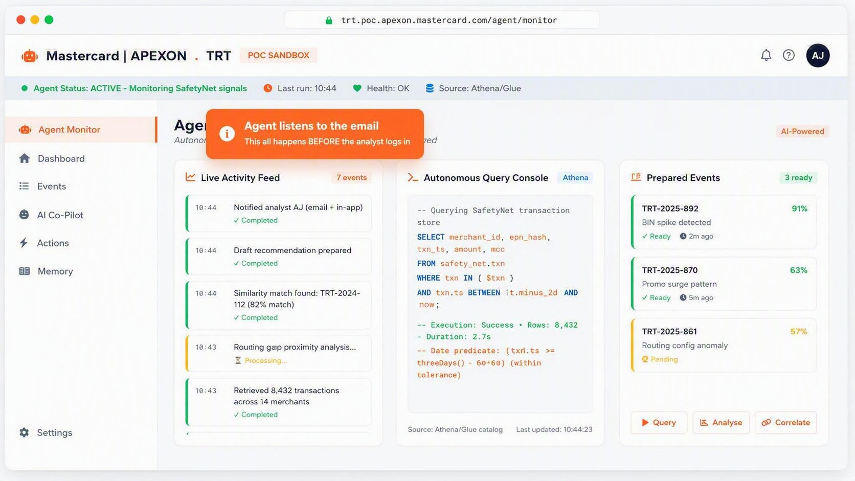

Slide 5
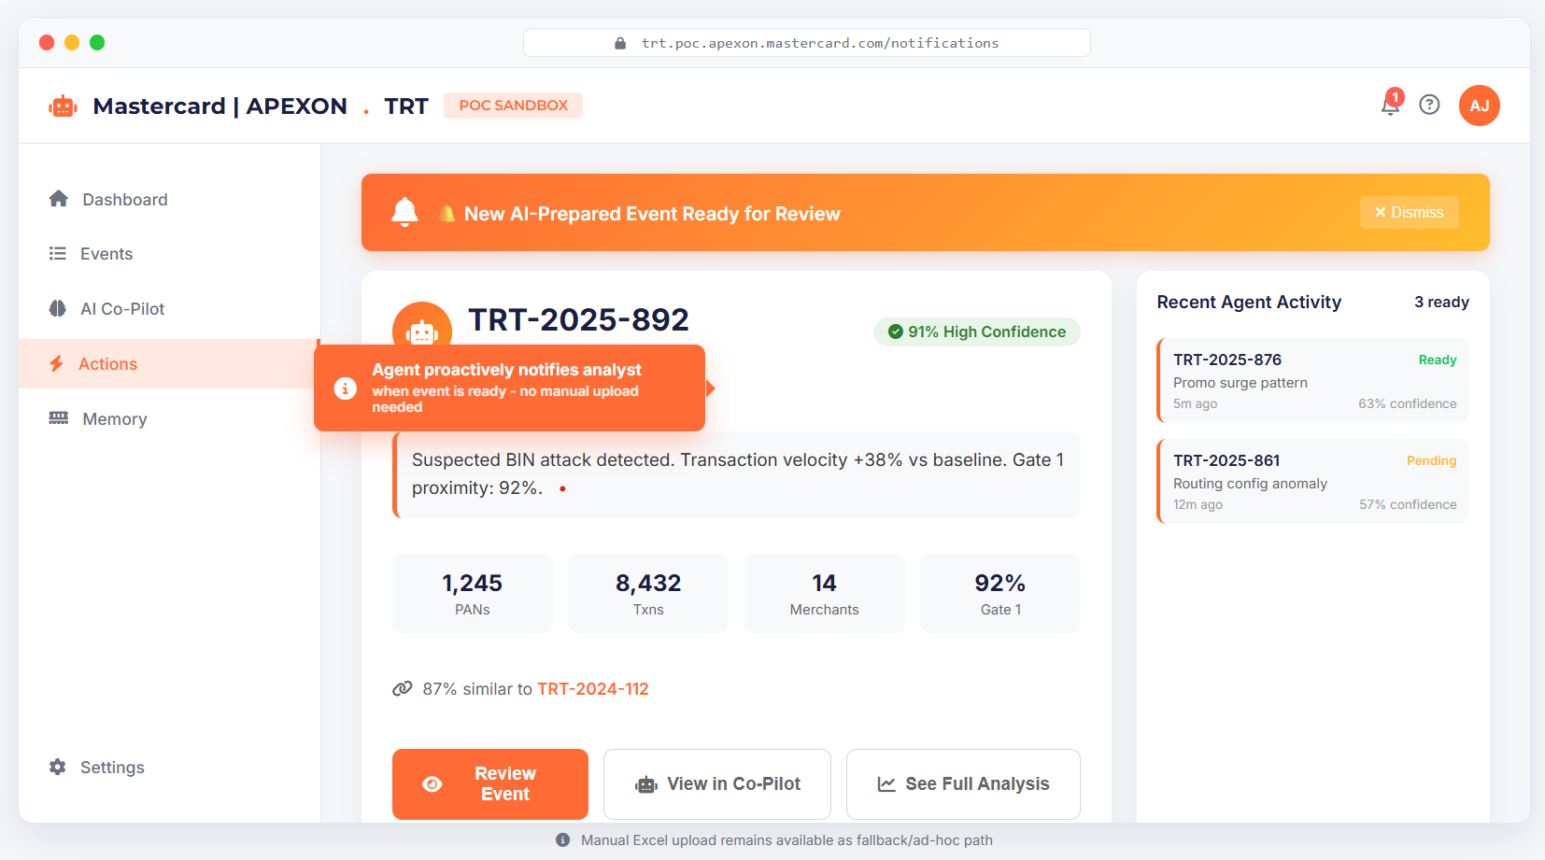

Slide 6
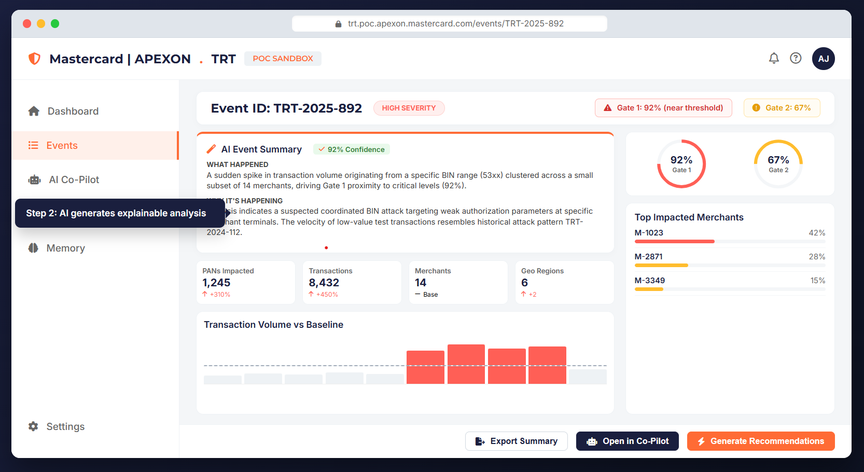

Slide 7
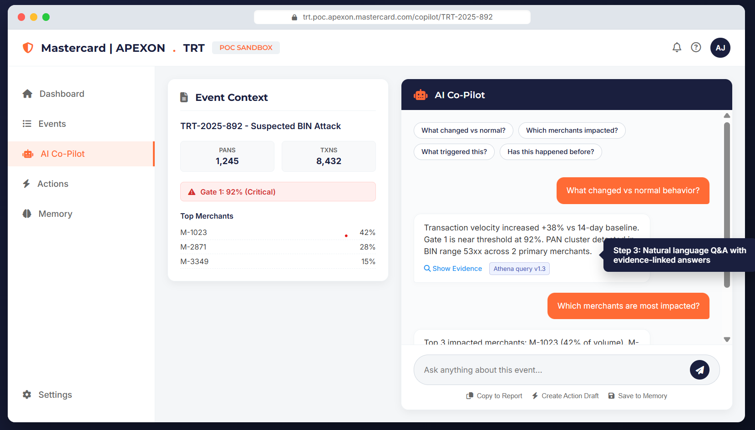

Slide 8



















trt.poc.apexon.mastercard.com/actions/TRT-2025-892
Mastercard | APEXON. TRT
AJ
PoC Sandbox
Recommended
Dashboard
Block/Monitor
Whitelist Merchant
Update Gate 1 Threshold
No Action
Apply Pattern
Resolved
Monitor traffic for 24h, alert if velocity exceeds 500 txns/hr
TRT-2024-112
Events
Whitelist M-1023 for 48h to prevent false positive blocks
Close event without any operational changes
Step 4: AI recommends actions with prefilled operational forms - one-click to execute
Increase Gate 1 to accommodate expected BIN traffic spike
Apply Pattern
Resolved
AI Co-Pilot
TRT-2024-087
Actions
Confidence
Apply Pattern
Confidence
72%
Confidence
91%
45%
Confidence
12%
TRT-2023-451
Escalated
Memory
Select
Select
Selected
Select
Uploaded
Analyzed
Reviewed
Action Pending
Export UDT Packet
Email to Ops
Submit Decision
Target Gate
Duration
Current Value
Proposed Value
Affected Merchants
TRT-2025-892
Justification (AI Generated)
Settings
Approver

Slide 9
Solution Themes
Three key capabilities to automate TRT analysis and decision support
01
02
03
◉
TRT Signal Detection
◉
Transactions Analysis
◉
Summary & Recommendations
Automatic Data Pull
Deep Dive & Insights
Actionable Insights
▤
Signal Activation
▤
Key Metrics Calculation
▤
AI-Generated Summary
Agent activates upon TRT Signal detection from SafetyNet
Volumes, velocity, merchant / PAN concentration, geo spread.
Plain-English event summary and rationale (explainable).
▤
Autonomous Gathering
▤
Contextual Reasoning
▤
Actionable Next Steps
Automatically queries transaction stores, Bears reports, EventHub, and historical data
Likely root causes, gate interactions, false-positive indicators.
Block / monitor, whitelist, threshold update, or no action.
▤
Automated Assembly
▤
Drill-down Analysis
▤
One-Click Export
No manual Excel upload needed - agent assembles all context autonomously with schema mapping and normalization
Impacted merchants / PANs, triggers, change drivers.
Structured report and prefilled forms (UDT / threshold / whitelist).
Confidential Information – For intended recipients only. Apexon, Copyright © 2026 All rights reserved.
10

Slide 10


AI-Assisted Solution Overview
Complete flow from data ingestion to memory & governance
01
▤
02
▤
03
▤
04
▤
05
▤
06
▤
07
TRT Signal Detection
Data Ingestion
Analysis & Context
Recommendations
Interaction Layer
Action Assistance
Memory & Governance
SafetyNet Signal
Agent-Initiated Pull
Metrics & Baselining
Explainable Summary
Visual Dashboard
Prefilled Outputs
Organizational Memory
Fraud detection trigger
From SafetyNet signal create the TRT Excel sheet
PANs, merchants, geos, thresholds
AI-generated rationale
Event flow & risk indicators
UDT / threshold forms
Past events
Decisions taken
Agent Activation
Transactions & Bears
Pattern Recognition
Action Recommender
Chat Co-Pilot
One-Click Export
Outcomes
Feedback
Autonomous wake-up
Auto-pull sources
Root cause analysis
Block / monitor / whitelist
Natural language queries
Email to downstream team
Metadata Capture
EventHub & History
Threshold Proximity
Decision Support
Ad-hoc Analysis
Workflow Integration
TRT ID, severity, gates
Historical data fetch
Gate interactions & insights
Clear next steps
Drill-down capabilities
Seamless handoff
Confidential Information – For intended recipients only. Apexon, Copyright © 2026 All rights reserved.
11

Slide 11































Azure Architecture for POC (illustrative stack)
Complete Azure service architecture for TRT Analysis & Operational Copilot
01
02
03
04
05
TRT Signal Detection
ETL & Query
Agentic AI
Experience Layer
Orchestration
Azure Blob Storage / ADLS Gen2
Azure Synapse Serverless SQL
Azure AI Foundry Agent Service
Azure Container Apps
Azure Logic Apps / Durable Functions
TRT Excel storage
Query uploaded data, transaction stores
Orchestration
UI/backend
Workflow
Azure Event Grid and Functions
Azure Cosmos DB
Azure OpenAI
Microsoft Entra ID (Azure AD)
Azure Communication Services Email
Signal routing and Agent activation
Event metadata
Analysis & recs
Authentication
Email/Export
Azure Data Factory
Azure Data Factory / Databricks
Azure AI Search
Co-Pilot UI
Azure API Management
Data extraction
Transform data
Vector search
Chat interface
API exposure
Data Validation
Knowledge Base
Azure Monitor + Application Insights
Schema parsing
Azure Data Factory Pipelines
Memory store
Dashboard
Monitoring
Orchestration
Visualization
Flow:
Flow:
Flow:
Upload → Blob → Functions→ Glue
Flow:
Data factory → Synapse → CosmosDB
AI Foundry → AI Search→ Agent
Flow:
Container Apps → Entra ID →
Co-Pilot UI
Logic Apps/Functions → Comm services → Export
Confidential Information – For intended recipients only. Apexon, Copyright © 2026 All rights reserved.
11

Slide 12



























Agent Orchestration Architecture (illustrative stack using Azure services)
Proactive data pull replacing manual Excel upload with autonomous data acquisition
Triggers
Azure AI Foundry Agent service
Active
Outputs
Azure Logic Apps Scheduler
Prepared Event Dashboard
Time-based triggers
Pre-analyzed incident ready
SafetyNet Event Grid / Event Hub
Think
Act
Observe
Refine
Notification to Analyst
Event stream signals
Logic Apps + Email + Teams
Azure Monitor Alerts
Populated Memory Store
Gate proximity alerts
Event + decision tracking
Manual Kickoff
Query SafetyNet
Parse/Normalize
Run Analytics
Search Memory
Draft Rec
Analyst initiated
Azure Data
Factory / Databricks
Metrics & baselines
Knowledge Bases
LLM via Azure
AI Foundry
Synapse over
Data Factory
Security: Microsoft Entra ID
+ RBAC
Encryption at rest/in transit
Audit logs
RBAC enabled
⚡ The agent monitors emails and kicks off from the SafetyNet Signals and does the data pull from DB/Datalake
Confidential Information – For intended recipients only. Apexon, Copyright © 2026 All rights reserved.
12

Slide 13
AWS Architecture for POC (illustrative AWS stack)
Complete Azure service architecture for TRT Analysis & Operational Copilot
01
02
03
04
05
TRT Signal Detection
ETL & Query
Agentic AI
Experience Layer
Orchestration
Amazon S3
Amazon Athena
Bedrock AgentCore
ECS Fargate
Step Functions
TRT Excel storage
Query uploaded data, transaction stores
Orchestration
UI/backend
Workflow
Event Bridge & Lambda
DynamoDB
Bedrock FMs
Cognito
SES
Signal routing and Agent activation
Event metadata
Analysis & recs
Authentication
Email/Export
Azure Glue
Azure Glue ETL
OpenSearch
Co-Pilot UI
API Gateway
Data extraction
Transform data
Vector search
Chat interface
API exposure
Data Validation
Data Pipeline
Knowledge Base
Dashboard
CloudWatch
Schema parsing
Orchestration
Memory store
Visualization
Monitoring
Flow:
Flow:
Flow:
Upload → S3 → Lambda → Glue
Flow:
Glue → Athena → DynamoDB
Bedrock → OpenSearch → Agent
Flow:
ECS → Cognito → Co-Pilot UI
Step Functions → SES → Export
Confidential Information – For intended recipients only. Apexon, Copyright © 2026 All rights reserved.
13

Slide 14
Agent Orchestration Architecture (illustrative stack using AWS Services)
Proactive data pull replacing manual Excel upload with autonomous data acquisition
Triggers
Bedrock AgentCore
Active
Outputs
Scheduled Cron
Prepared Event Dashboard
Time-based triggers
Pre-analyzed incident ready
SafetyNet Event
Think
Act
Observe
Refine
Notification to Analyst
Event stream signals
In-app + email alerts
Threshold Breach
Populated Memory Store
Gate proximity alerts
Event + decision tracking
Manual Kickoff
Query SafetyNet
Parse/Normalize
Run Analytics
Search Memory
Draft Rec
Analyst initiated
Athena over Glue
Glue jobs
Metrics & baselines
Knowledge Bases
LLM via Bedrock
Security: Cognito/IAM
Encryption at rest/in transit
Audit logs
RBAC enabled
⚡ The agent monitors emails and kicks off from the SafetyNet Signals and does the data pull from DB/Datalake
Confidential Information – For intended recipients only. Apexon, Copyright © 2026 All rights reserved.
14

Slide 15
AWS Architecture for POC (illustrative stack)
Complete AWS service architecture for TRT Analysis & Operational Copilot
01
02
03
04
05
TRT Signal Detection
ETL & Query
Agentic AI
Experience Layer
Orchestration
Amazon S3
Amazon Athena
Bedrock AgentCore
ECS Fargate
Step Functions
TRT Excel storage
Query uploaded data, transaction stores
Orchestration
UI/backend
Workflow
Event Bridge & Lambda
DynamoDB
Bedrock FMs
Cognito
SES
Signal routing and Agent activation
Event metadata
Analysis & recs
Authentication
Email/Export
AWS Glue
AWS Glue ETL
OpenSearch
Co-Pilot UI
API Gateway
Data extraction
Transform data
Vector search
Chat interface
API exposure
Data Validation
Data Pipeline
Knowledge Base
Dashboard
CloudWatch
Schema parsing
Orchestration
Memory store
Visualization
Monitoring
Flow:
Flow:
Flow:
Upload → S3 → Lambda → Glue
Flow:
Glue → Athena → DynamoDB
Bedrock → OpenSearch → Agent
Flow:
ECS → Cognito → Co-Pilot UI
Step Functions → SES → Export
Confidential Information – For intended recipients only. Apexon, Copyright © 2026 All rights reserved.
15

Slide 16
Agent Orchestration Architecture (illustrative stack)
Proactive data pull replacing manual Excel upload with autonomous data acquisition
Triggers
Bedrock AgentCore
Active
Outputs
Scheduled Cron
Prepared Event Dashboard
Time-based triggers
Pre-analyzed incident ready
SafetyNet Event
Think
Act
Observe
Refine
Notification to Analyst
Event stream signals
In-app + email alerts
Threshold Breach
Populated Memory Store
Gate proximity alerts
Event + decision tracking
Manual Kickoff
Query SafetyNet
Parse/Normalize
Run Analytics
Search Memory
Draft Rec
Analyst initiated
Athena over Glue
Glue jobs
Metrics & baselines
Knowledge Bases
LLM via Bedrock
Security: Cognito/IAM
Encryption at rest/in transit
Audit logs
RBAC enabled
⚡ The agent monitors emails and kicks off from the SafetyNet Signals and does the data pull from DB/Datalake
Confidential Information – For intended recipients only. Apexon, Copyright © 2026 All rights reserved.
16

Slide 17



















Assumptions & Dependencies
Key requirements and stakeholder engagement for successful PoC execution
Key Assumptions
Dependencies from Mastercard
Synthetic Data: PoC uses synthetic/anonymized TRT data; no production access; no PII; encryption in transit/at rest.
Data Format: Representative TRT Signal Data/ Excel formats and sample alert emails will be provided by Mastercard.
Data Package
10-20 historical TRT reports covering varied scenarios (BIN attack, promo spike, routing config issues)
Environment: Apexon-hosted Azure sandbox for the PoC or Mastercard provided; outbound actions (emails/exports) simulated.
Access Decisions
Domain Inputs: Gate definitions (Gate1/Gate2), threshold references, merchant/PAN metadata, glossary.
SSO/SAML federation or Cognito test users; allow-listing for demo access
UAT Coordination
Timeline: 10-week delivery with weekly checkpoints and rapid feedback cycles.
Access: SSO/SAML or Cognito test users; allow-listing for demo access if needed.
Acceptance criteria, test cases, and 3-5 analysts for evaluation sessions
Required Stakeholders
Reaffirmed Constraints
TRT Lead
Fraud Ops SME
Out of scope: Fraud detection, real-time streaming
Operational SME
Domain Expert
Out of scope: Automated production rule deployment
Out of scope: Splunk/X-Matters/Bears integration
Data Steward
Security/Compliance
Out of scope: Real-time transaction blocking
Data Management
Governance
Confidential Information – For intended recipients only. Apexon, Copyright © 2026 All rights reserved.
17

Slide 18










10-Week Pilot Estimates
Timeline breakdown, team composition, and milestone deliverables
Timeline Overview
Team Composition
Weekly breakdown of deliverables and milestones
Resource allocation
1-2
3-4
5-6
7-8
9-10
Tech Lead (Onsite)
Data Model
Analysis
Chatbot
Memory
Final Demo
Week 1-2
Week 3-4
Week 5-6
Data Engineer
Data model + ingestion + UI foundation
Analysis + recommendation + chatbot
Memory + workflow + demo
ML/AI Engineer
Milestone Deliverables
Key deliverables by phase
Full-Stack Dev
M1 (Wk 2-4): Ingestion pipeline + UI scaffold
Week 2
UX Designer
M2 (Wk 5): Analysis + explainable recommendations MVP 1
Week 5
M3 (Wk 7): Co-pilot + visual TRT dashboard
Week 7
QA Engineer
M4 (Wk 9): Memory, feedback, audit trail
Week 9
Page 3 of 4
M5 (Wk 10): Final demo package and documentation
Week 10
Total Price: USD 175,000
Exclusive of any taxes and travel
Confidential Information – For intended recipients only. Apexon, Copyright © 2026 All rights reserved.
18

Slide 19
Roadmap – From PoC to Production
The PoC is 10 weeks. The enterprise gates are the rest.
M1
M2
M3
M4
M5
M6
M7
M8
M9
M10
M11
M12
ARB Gate
Prod Cutover
Handover
01
Months 1–3 · 10 wks
02
Months 4–5 · ~8 wks
03
Months 6–7 · ~8 wks
04
2 wks
PoC · Working AI Agent
Enterprise Architecture (ARB) Approval
Business QA & Production Deployment
Hypercare
Mastercard sandbox · synthetic TRT data · 10-week pilot
Mastercard ARB · Security · Compliance · Data Governance
Mastercard sandbox→ Mastercard production · real data · real integrations
Post-go-live stabilization · feedback tuning · handover
KEY ACTIVITIES
KEY ACTIVITIES
KEY ACTIVITIES
KEY ACTIVITIES
· Data ingestion + UI (Wk 1–2)
· Analysis + explainable recs (Wk 3–5)
· Co-Pilot + TRT dashboard (Wk 5–7)
· Memory · audit · demo (Wk 8–10)
· Enterprise architecture + ARB sign-off
· InfoSec · encryption · secrets · RBAC
· Data governance · PII · retention
· Prod tenant + Microsoft stack lock-in
· Migration/Deployment to Prod tenant
· SafetyNet · Bears · EventHub live wiring
· UAT with 3–5 TRT analysts · sign-off
· Analyst training + Wave-1 go-live
· Hypercare · defect triage · SLO tuning
· Org-memory refinement · real events
· Agent tuning · analyst feedback loop
· KT · runbooks · handover to Mastercard ops
Exit → Working PoC · validated architecture · ready for ARB submission
Exit → ARB-approved architecture · production tenant ready · SSO/SAML live
Exit → System live on real signals · analysts operating · hypercare begins
Exit → Steady-state · Apexon transitions to on-call support
Apexon delivers the PoC in 10 weeks. The rest of the duration is Mastercard's own governance: ARB approval · InfoSec · data governance · production cutover · hypercare. Enterprise gates.
$175,000 (Fixed fee)
$30,000 per month to support production deployment
Confidential Information – For intended recipients only. Apexon, Copyright © 2026 All rights reserved.
20

Slide 20















Deployment Strategy: Hybrid Approach
Phase 1: Build fast in Apexon environment (Weeks 1-4) | Phase 2: Transfer to Mastercard (Weeks 5-10)
Phase 1: Build Fast
Phase 2: Transfer
Dependencies
Weeks 1-4
Weeks 5-10
Critical Requirements
1
Week 1: Setup & Ingestion
5
Week 5: Environment Setup
10-20 TRT reports
SSO/SAML access
Azure sandbox setup, S3 bucket creation, initial data pipeline
Mastercard VPC, SSO integration, security config
Security approval
3-5 analysts UAT
6
Week 6: Data Migration
Test data package
2-day feedback
2
Week 2: Data Pipeline
Transfer to Mastercard environment, data validation
Glue ETL, Athena queries, DynamoDB setup
3
Week 3: Analysis Engine
7
Week 7: Integration
Bedrock integration, analysis logic, recommendations
Connect to Mastercard systems, tune thresholds
4
Week 4: UI Development
8-10
Weeks 8-10: UAT & Handover
Dashboard, chat interface, visual components
Testing, documentation, knowledge transfer
Risk Mitigation
Success Criteria
Key Risks
Start off-network to avoid approval delays
Faster analyst TAT
Approval bottlenecks
Use synthetic data for initial testing
Explainable recommendations
Data readiness
Prepared by: Apexon Team
Contact: team@apexon.com
Page 9 of 9
Confidential Information – For intended recipients only. Apexon, Copyright © 2026 All rights reserved.
20

Slide 21

















Apexon vs others: Why Apexon for TRT PoC
Timeline breakdown, team composition, and milestone deliverables
APEXON
OTHERS
KEY DIFFERENTIATORS
Problem-First Approach
Platform-First Approach
10 Critical Factors
Deep Customization
Generic Platform
Customization
Speed
Tailored to Mastercard's TRT workflow, not generic platform
Product-centric, not workflow-specific
Explainability
Memory
Technology Neutral
Azure-Centric
Integration
Cost Control
Azure, Azure, GCP, PCF - not locked to one cloud
Locked to Azure ecosystem
Flexibility
Support
Faster Time-to-Value
Longer Onboarding
8-10 weeks vs 6-8 months onboarding
6-8 months for introduction of a new stack
Security
Scalability
Explainable AI
Black-Box AI
Clear rationale, evidence trails, auditability
Limited explainability
Organizational Memory
Limited Memory
Persistent fraud knowledge graph
Session-based, no persistence
Apexon Advantage
Competition Limitation
We solve Mastercard's problem, not showcase a platform. Deep domain expertise in SafetyNet, BIN attacks, and TRT workflows.
Focused on Azure AI platform demonstration, not operational workflow optimization.
Confidential Information – For intended recipients only. Apexon, Copyright © 2026 All rights reserved.
21

Slide 22





















Apexon Differentiators
10 key competitive advantages for Mastercard TRT PoC
01
02
03
04
05
Deep Customization
Technology Neutral
Faster Time-to-Value
Hybrid Build-Transfer
Practical Execution
Tailored to Mastercard's exact TRT workflow, not generic platform
Build on Mastercard's chosen stack (Azure/Azure/GCP/PCF)
Avoid 8-month onboarding; deliver in 8-10 weeks
Start in Apexon environment, then transfer to Mastercard
Navigate approvals, de-risk integrations, focus on outcomes
SafetyNet Integration: Designed around specific operational processes
Multi-Cloud: No vendor lock-in, flexible deployment
Quick Start: Use existing stack for immediate value
Phased Approach: Build fast, then migrate
Constraint Management: Execute under pressure
06
07
08
09
10
Domain-First Approach
Explainable AI
Organizational Memory
Agentic Automation
Path to Production
SafetyNet/BIN attacks/gate logic embedded into reasoning
Plain-English rationale, thresholds context, evidence trails
Persistent incident knowledge, similarities, analyst actions
From insight → action: prefill UDT/threshold updates
Enterprise delivery, governance, auditability, rollout readiness
Operational Knowledge: Deep domain expertise
Transparency: Clear decision reasoning
Knowledge Graph: Historical pattern recognition
Workflow Automation: End-to-end execution
Production-Ready: Scalable architecture
Confidential Information – For intended recipients only. Apexon, Copyright © 2026 All rights reserved.
22

Slide 23
Thank you
May 2026
Notes:
Guidelines Start Here…

